Slide 1

FP&M SETA MANDATORY ANDDISCRETIONARY
GRANT WORKSHOPS 2023/24
SETA PERFORMANCE

Slide 2
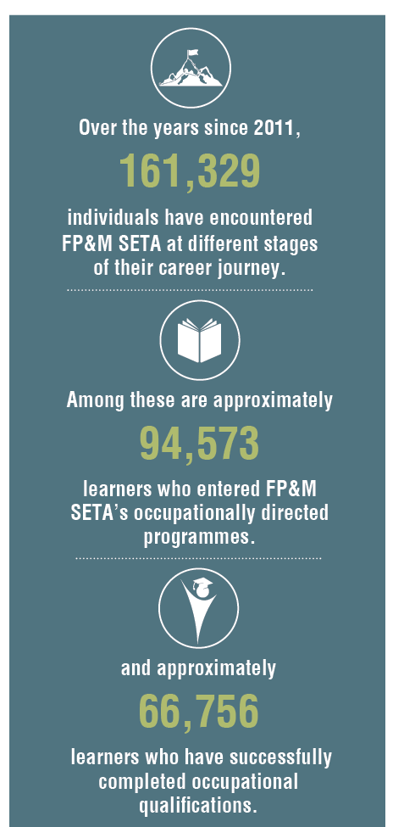
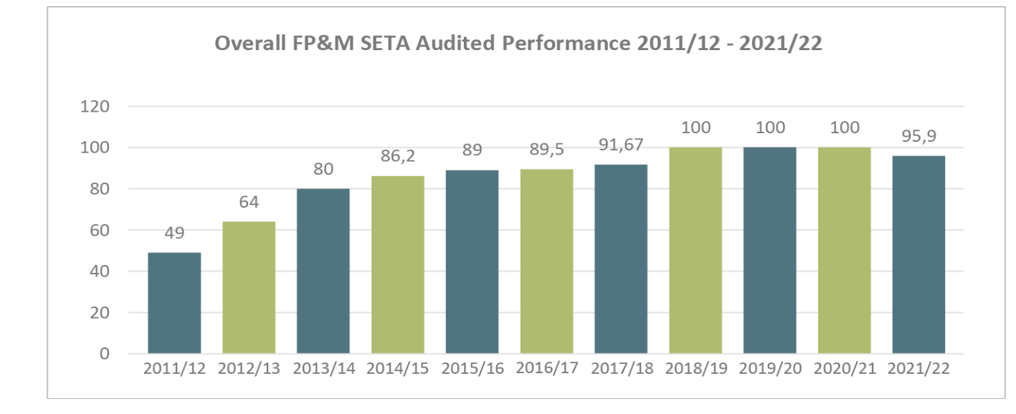

OVERALL PERFORMANCE

Slide 3
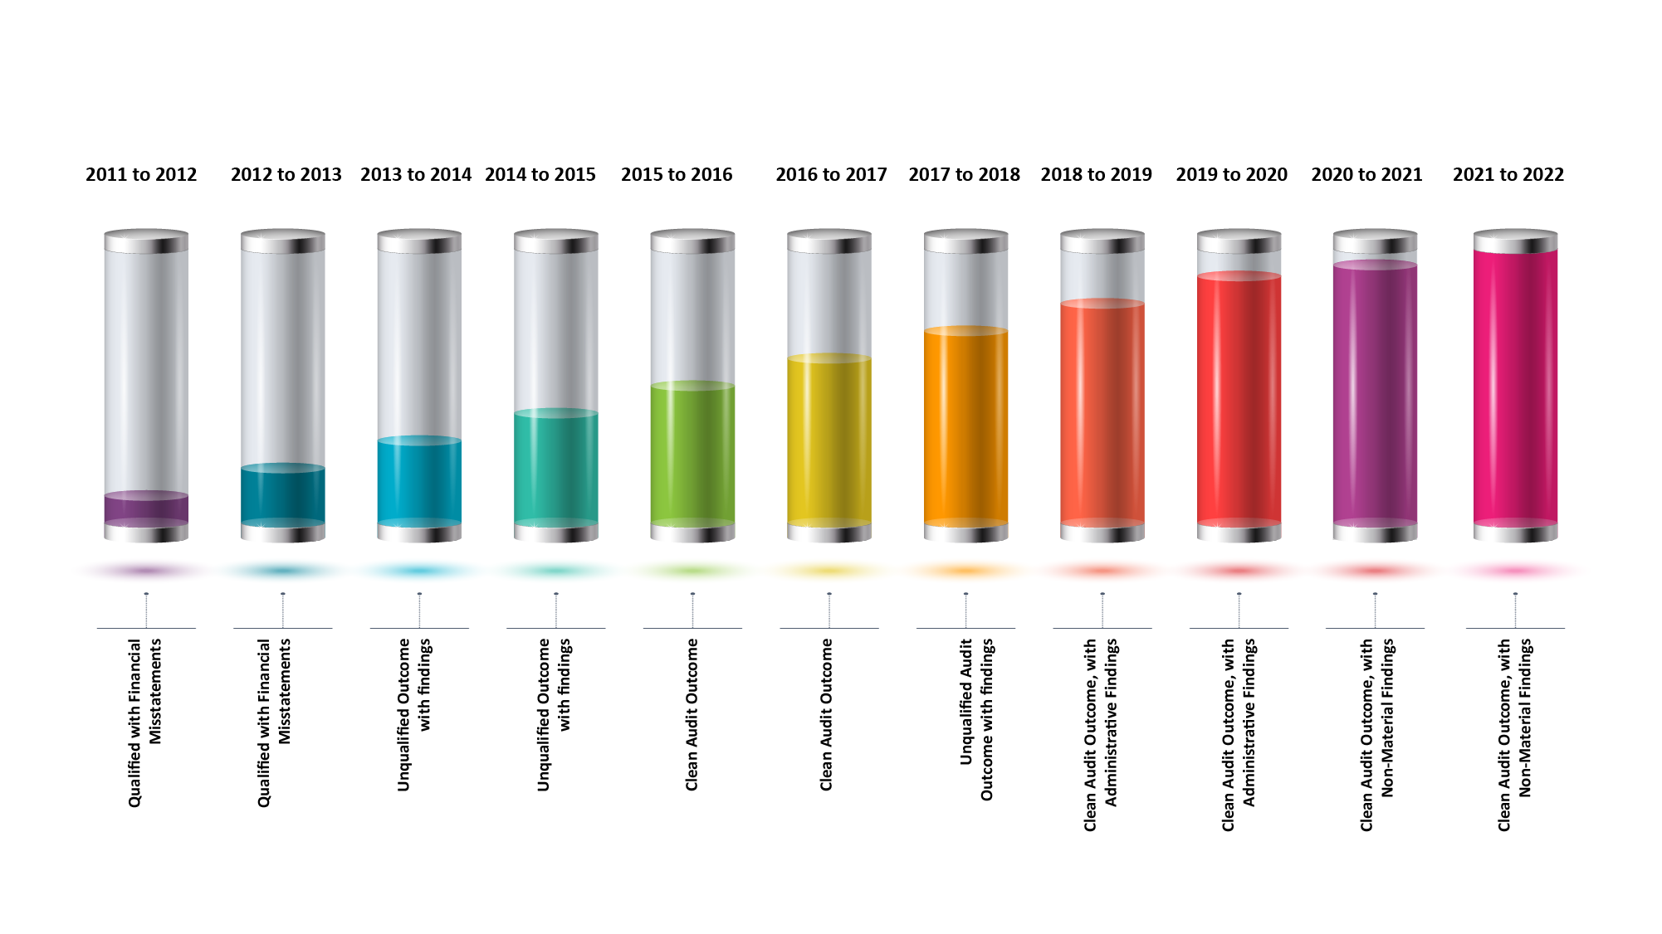
AUDIT OUTCOME
The FP&M SETA received its sixth unqualified clean audit-opinion in the 2021/22 financial year, which is testament to our pursuit of total compliance, good corporate governance and service delivery.
Fourth consecutive Clean Audit Opinion from AGSA

Slide 4

FP&M SETA
HIGHLIGHTS

Slide 5
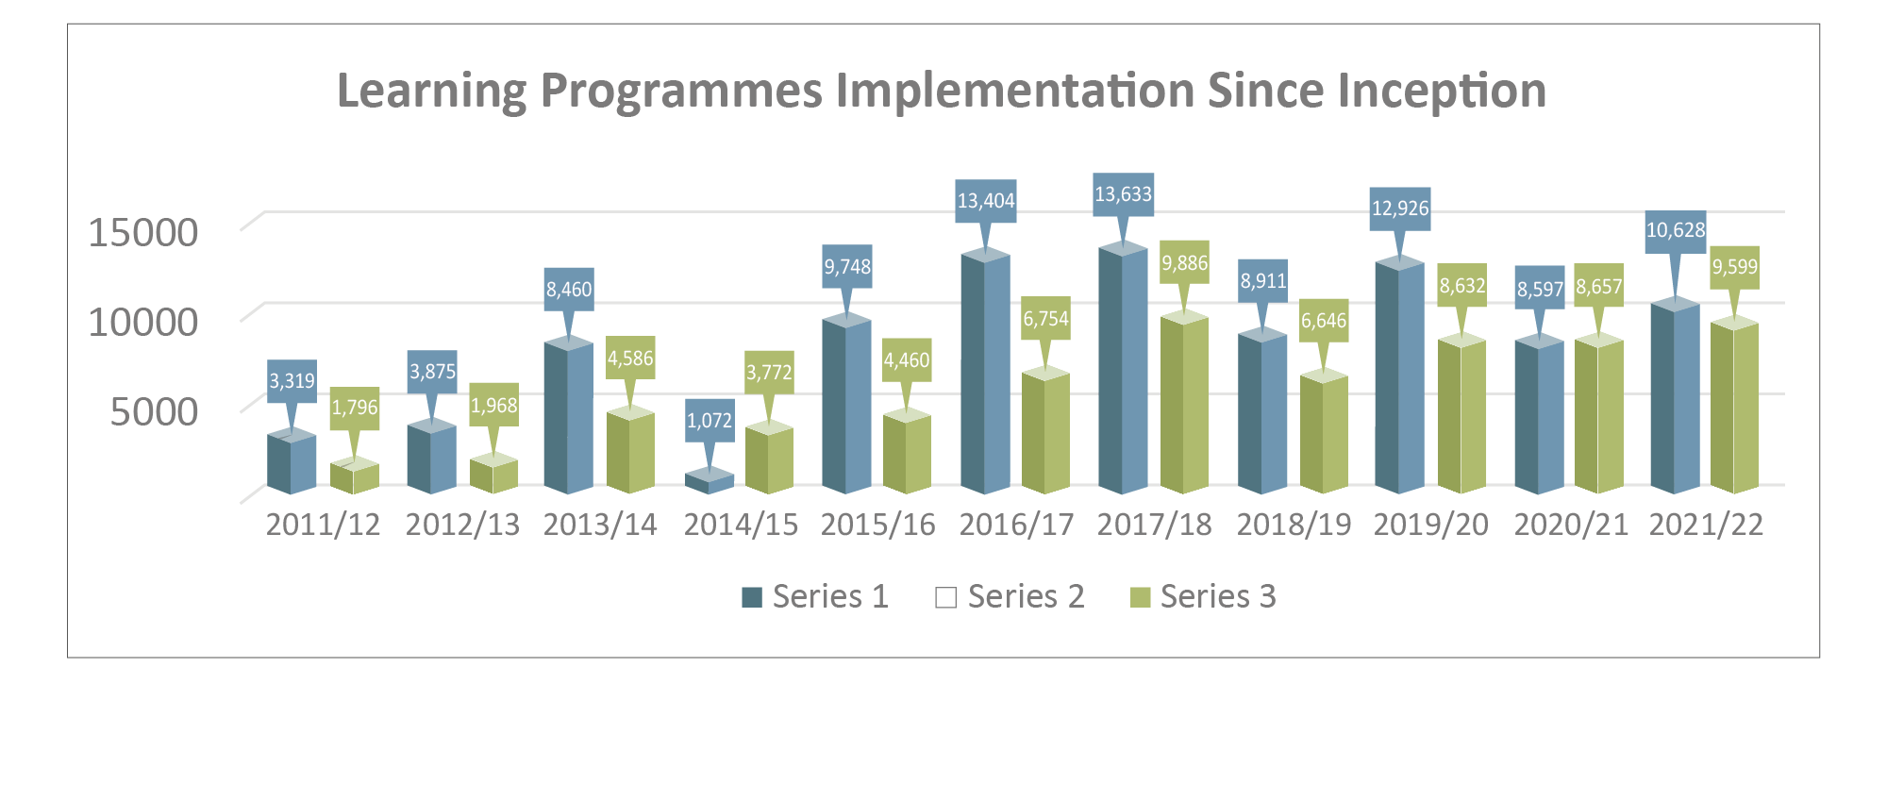
SETA PERFOMANCE ON LEARNING PROGRAMMES

Slide 6

FP&M SETA
PERFORMANCE
AS PER NSDP OUTCOMES

Slide 7
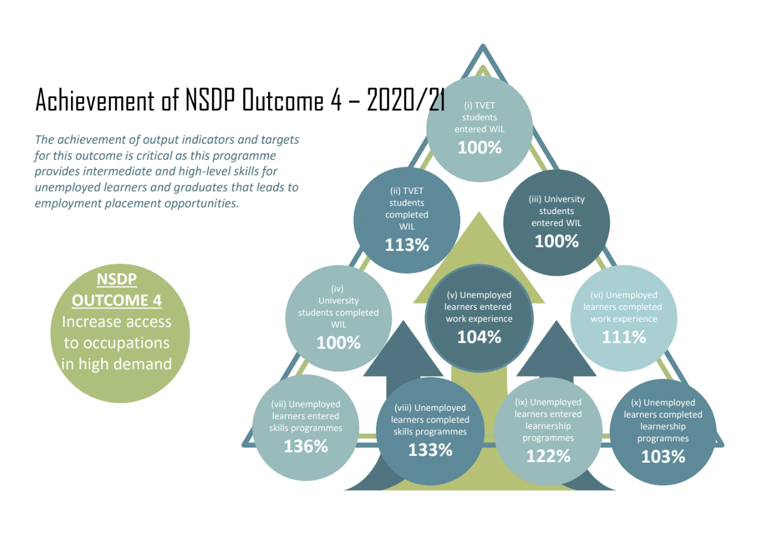
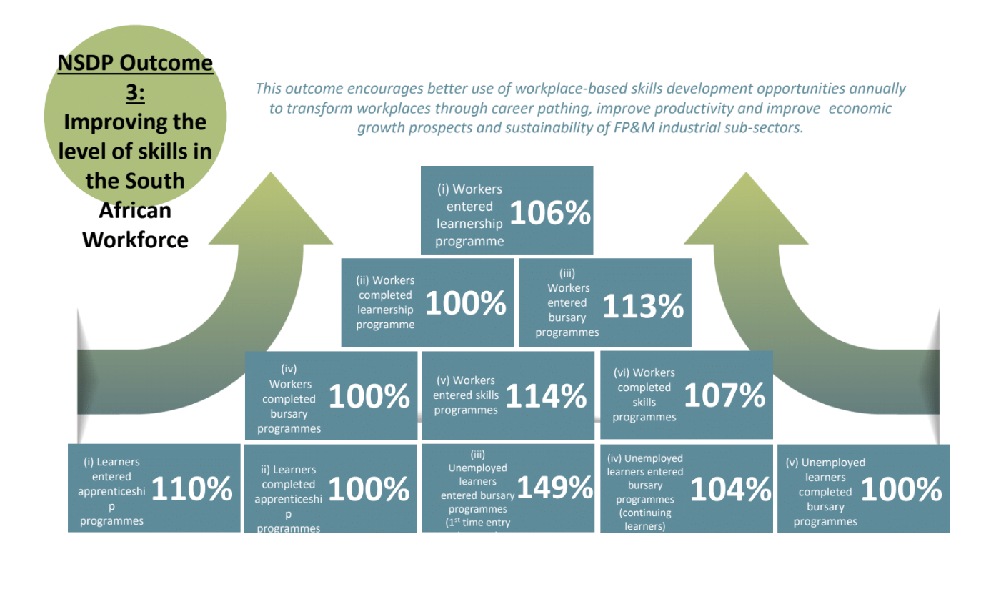
ACHIEVEMENT OF NSDP
ACHIEVEMENT OF NSDP OUTCOME 4 2021/22
INCREASE ACCESS TO OCCUPATIONS IN HIGH DEMAND
IMPROVING THE LEVEL OF SKILLSIN THE SOUTH AFRICAN WORKFORCE
The achievement of output indicators and targets for this outcome is critical as this programme provides intermediate and high level skills for unemployed learners and graduates that leads to employment opportunities
This outcome encourages better us of workplace-based skills development opportunities annually to transform workplaces through career pathing, improve productivity and improve economic growth prospects and sustainability of FP&M industrial sub-sectors.
2021/22
109%
106%
104%
129%
101%
100%
101%
117%
101%
43%
104%
120%
168%
136%
112%
119%
134%
107%
108%
100%
131%

Slide 8
IMPACT ASSESSMENT UNDERTAKEN ON:
The impact of the SETA programmes and projects, including tracer studies

Slide 9
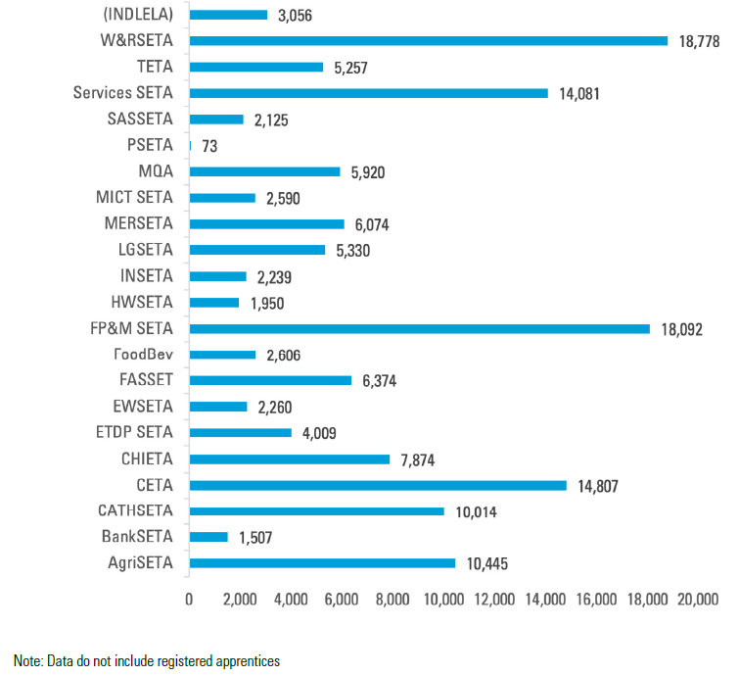
UNEMPLOYED LEARNERS IN WBL PROGRAMS
REGISTERED - 2019/20
ENGAGEMENT OF MICRO AND SMALL ENTERPRISES IN WORKPLACE-BASED LEARNING IN SOUTH AFRICA
Learners are formally registered in all 21 SETAs covering a large range of occupations
Reference: World Bank / DHET Research Study (2022)

Slide 10
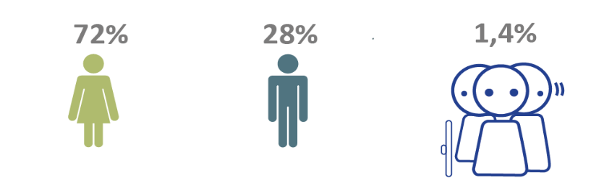
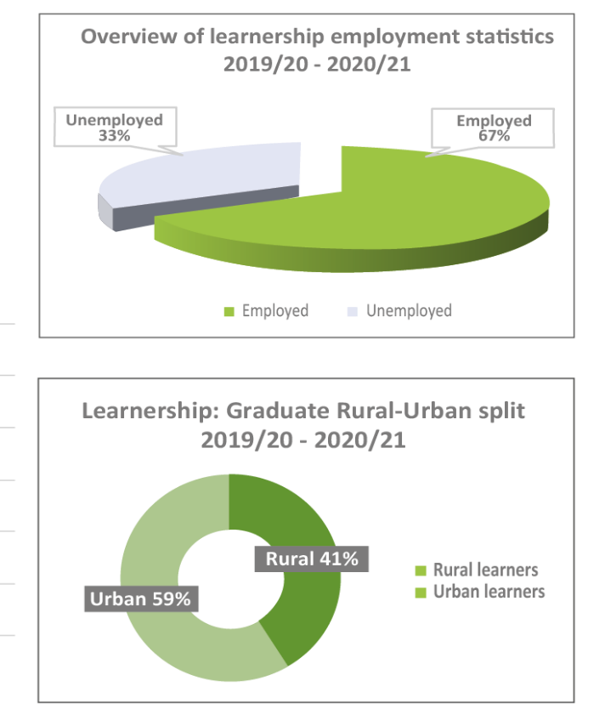
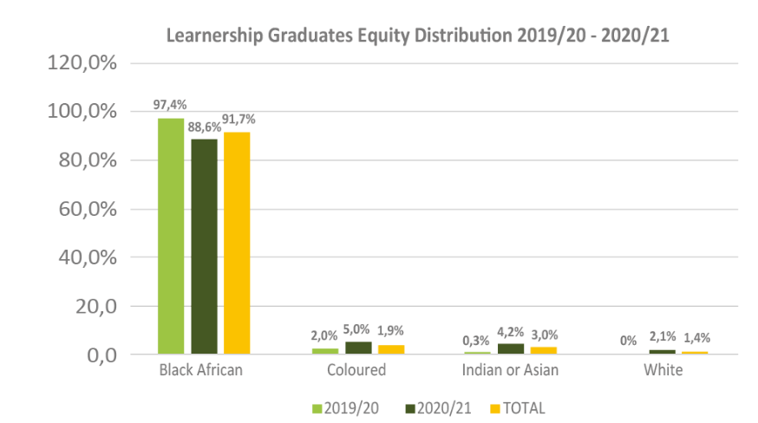
IMPACT STUDY - LEARNERSHIPS

Slide 11
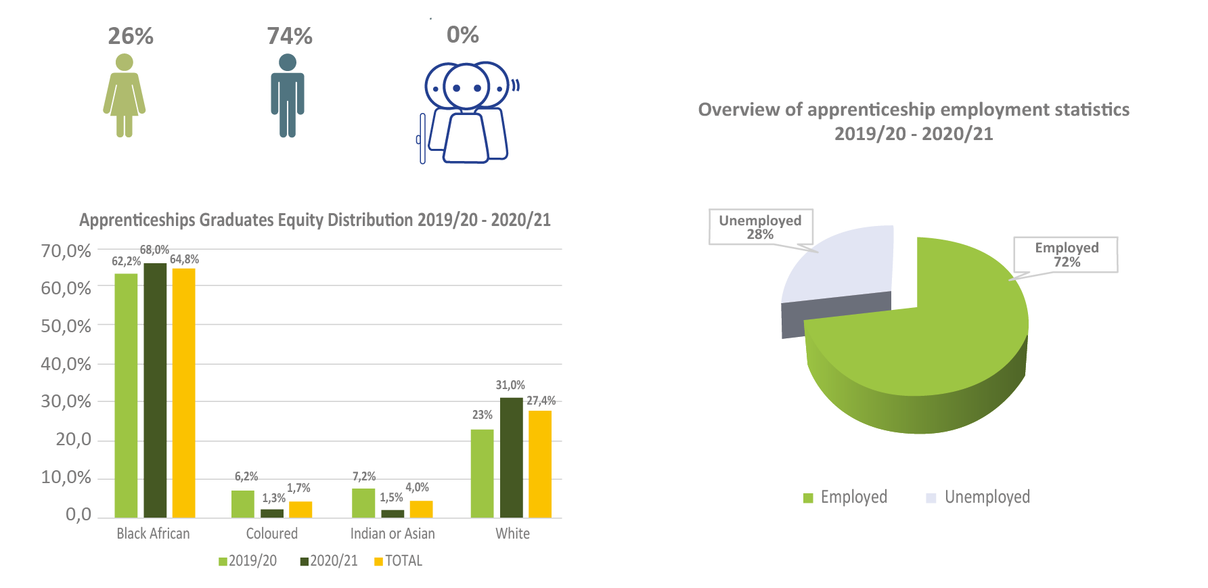
IMPACT STUDY - APPRETICESHIPS

Slide 12
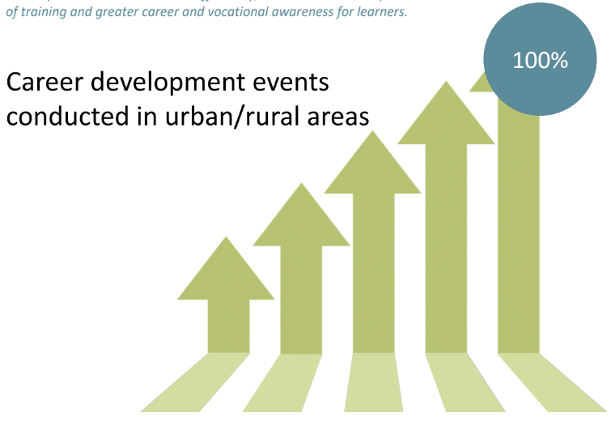
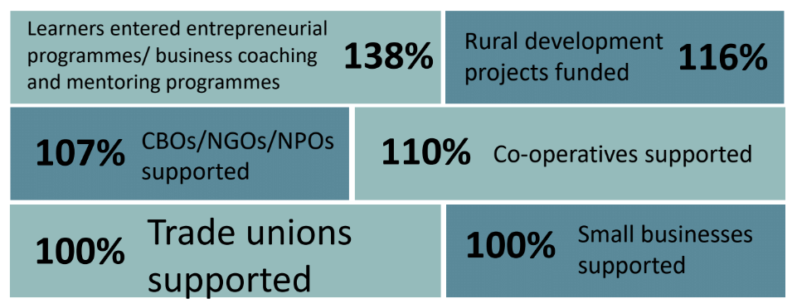
ACHIEVEMENT OF NSDP
NSDP OUTCOME 8
NSDP OUTCOME 6
SKILLS DEVELOPMENT SUPPORT FOR ENTREPRENEURSHIP AND COOPERATIVE DEVELOPMENT
CAREER DEVELOPMENT
Funded skills and entrepreneurial interventions will result in the establishment of new enterprises and co-operatives, thus increasing employment and new venture opportunities. Co-operative, Small Enterprises, CBOs, NPOs, NGOs must be supported, with skills training and capacity development in order to expand and contribute to sector economic and employment growth.
Career paths are communicated effectively, and contribute to improved relevance of training and greater career and vocational awareness for learners.
106%
103%
223%
100%
100%
101%

Slide 13

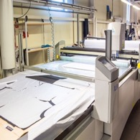
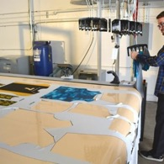

SPECIAL PROGRAMMES
Manufacturing Enhancement For Future Leaders:
Technical Skills Development –
Work experience for TVET/HET Graduates:
Future Skills Programme:
CodeSpace Coding & Robotics
Technical Skills Programme: Learnerships
Automation & Mechanisation skills
180 Learners benefitted
Create jobs
Create opportunities for new businesses
Empower innovative
problem-solving
Providing decentralised access to digital tools & training
Building business
& technical skills
of innovators
MECHANISATION
AUTOMATION
CODING & ROBOTICS
The Richmond–Indaleni Innovation Co-Lab aims to support local entrepreneurs, designers, small scale manufacturers, and innovators, working in the FP&M sector, to further develop themselves, and their ideas.
The SA R-CTFL value chain needs to close existing technology and competitiveness gaps and embrace new technologies and the operating models these technologies give rise to. The support for 4th industrial revolution is therefore critical at abstract and more applied levels.

Slide 14

OUTCOME: QUALITY ASSURANCE
TVET/CET lecturers
entered industry
development
programmes
187%
TVET/centres of
specialisation funded
100%
CSTO offices
established in
TVET Colleges
100%
QCTO Occupational
qualifications
development
100%

Slide 15

Thank You

